Slide 1
www.bridges5-0.eu
Industry 5.0: Making workers and civil society strong
A comprehensive approach for skill-based human centricity and stronger focus on social challenges
Dr. Ralf Kopp and Antonius Schröder / TU Dortmund – Social Research Centre, Germany
Workplace Innovation Europe: Empowerment, Participation and Democratisation: Prospects for Industrial Work (Webinar)
January 30, 2026

Slide 2
Bridges 5.0-Project
Industrie 4.0: Better than its reputation – but not good enough!?
Industry 5.0: The ignored dimension
Paths to a regional innovation eco-system
Conclusion: Hope dies last!

Slide 3

Achieving the transition from 4.0 to 5.0
01.01.2023 - 31.12.2026
20 Partner from research and enterprises
Focus:
Human centrification of technology
Organisation and configuration of technology
Enhancment of workforce skills for Industry 5.0
Green skills and digital skills
Creation for a better learning experience
Teaching factory and learning factory
Change of behaviour and practices
Target Groups: manager, employees, job seekers, students
Quantitatively map how jobs are transforming
Map Industry 5.0 skills and skill gaps
Learning trajectories & training pathways
(Learning Factory/
Teaching Factory)
Industry 5.0 Web Platform
Networking with companies, social partners,
industrial networks, education

Slide 4
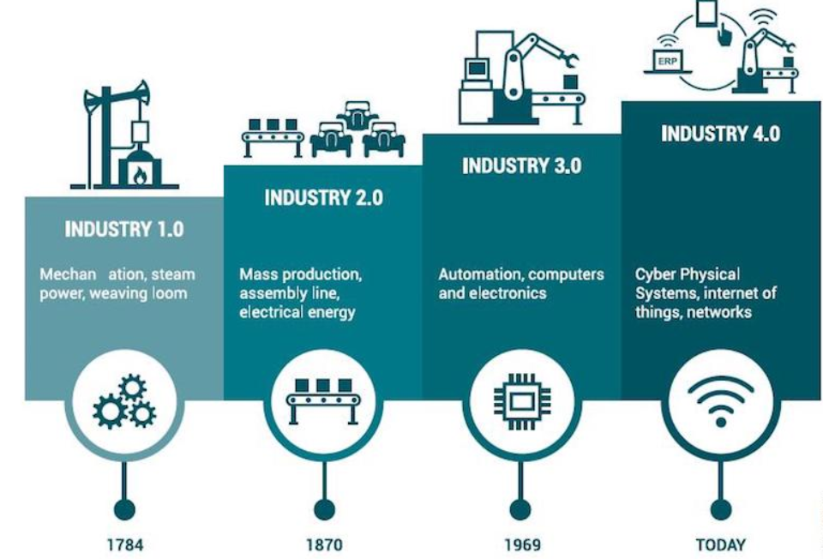
Industrie 4.0 (Germany 2011)
Industry 4.0 is about making manufacturing digital, interconnected, intelligent, and autonomous.
Cyber-physical systems (CPS): Machines and devices that are connected digitally and can interact with each other.
IoT (Internet of Things): Devices and sensors connected to collect and share data.
Smart factories: Factories where systems can monitor processes, make decisions, and improve efficiency autonomously.
Real-time analytics: Data is processed instantly to optimize operations and predict failures.
Limitations
Traditional Goals: efficiency, productivity, optimization
Tech-centric focus: automation, AI, networked systems
Human labor should adapt to technology
Social factors are secondary

Slide 5
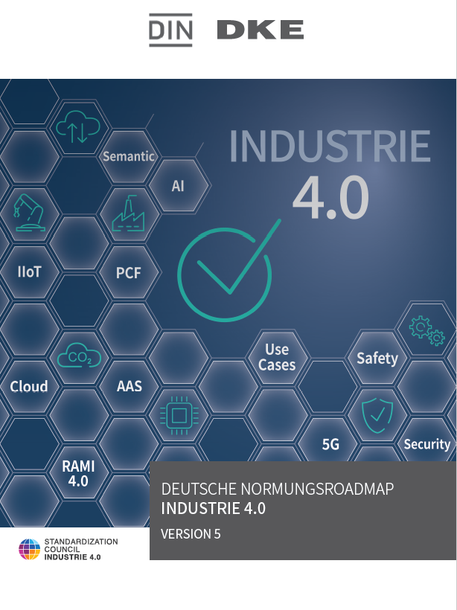
Numerous differentiated and interrelated concept papers
Strengthening of Socio-Technical-Systemthinking
Human Centrification: Operator 4.0
Sustainability / Green Skills and Resilience
Mission statement 2030: Three pillars: Sovereignty, interoperability and sustainability (good work and education, circular economy, societal participation)
It is noted "that a human-centred design of Industry 4.0 work systems requires early consideration of socio-technical aspects (…), and the earliest possible involvement of workers in the Industry 4.0 value creation system in a key user role (ideally as design partners). In this context, the practical knowledge of workers (…) should be captured, documented (…) and utilised for the more human-centred design of the respective Industry 4.0 system currently under development and introduction (…).“ (Source: DIN/DKE (2023): Deutsche Normungsroadmap Industrie 4.0, Version 5, p.16 – Translation: R. Kopp)
But: Concept ≠ Reality

Slide 6
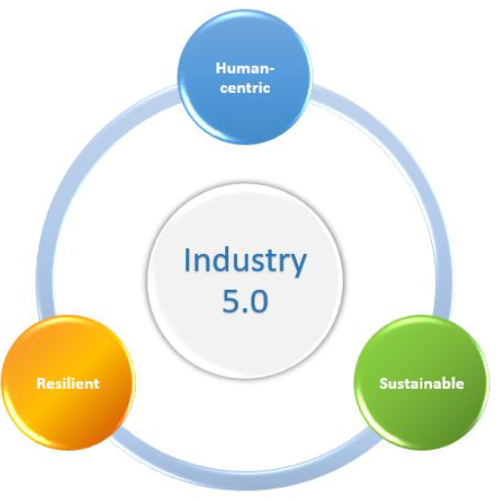
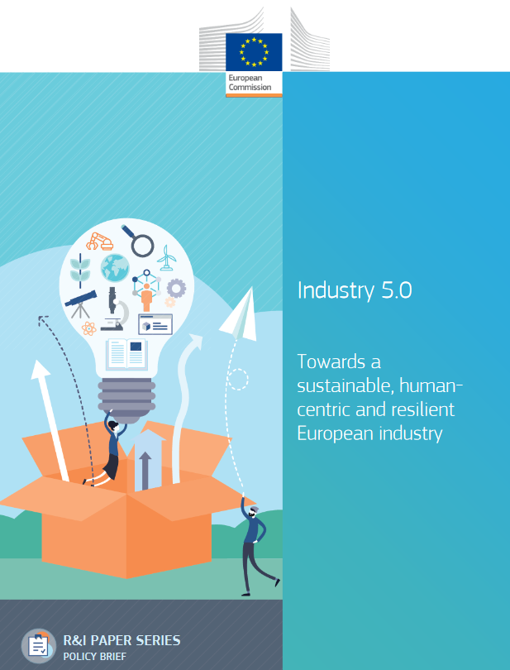
Industry 5.0 (EU 2021)
industrial worker
society challenges
circular processes
reduce energy, emission, waste
increase efficiency
security of infrastructure
robustness against disruption
The three defining characteristics of Industry 5.0 (Source: Breque et al., 2021, 13)
Necessary, but ‘fair and good’ work alone can still sustain profit-driven but resource-intensive systems!

Slide 7
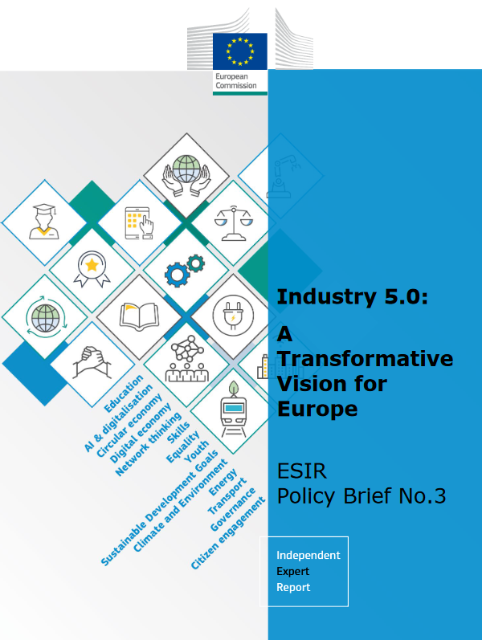
„Industry 5.0 means first and foremost a decisive move away from neo-liberal capitalism models with a focus on production for profit and “shareholder primacy”, towards a more balanced view of value over time and a multi-valent understanding of capital – human and natural as well as financial. This (…) requires a people-planet-prosperity approach that focuses on short-term levers and long-term planning rather than short term profit seeking. (…) Even the increasingly popular notion of “stakeholder capitalism”, while recognising corporate responsibility for ensuring that all relevant interests represented in the firm are catered for, is insufficient to enable a full transition to Industry 5.0.“
(Renda et al., 2021, 7)

Slide 8
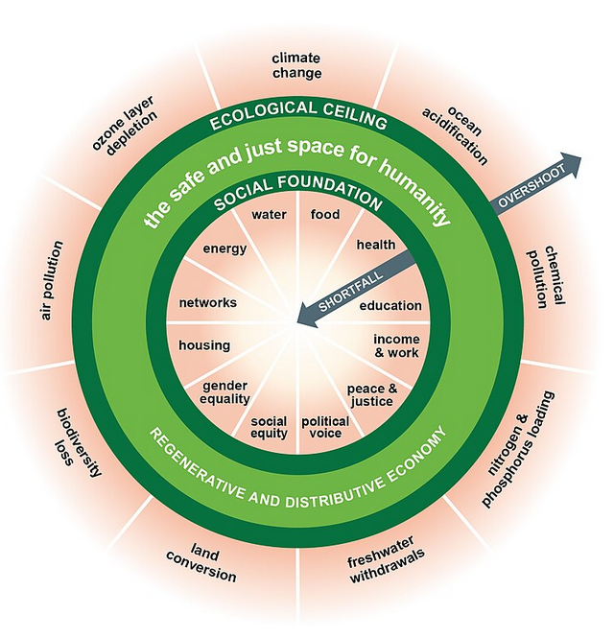
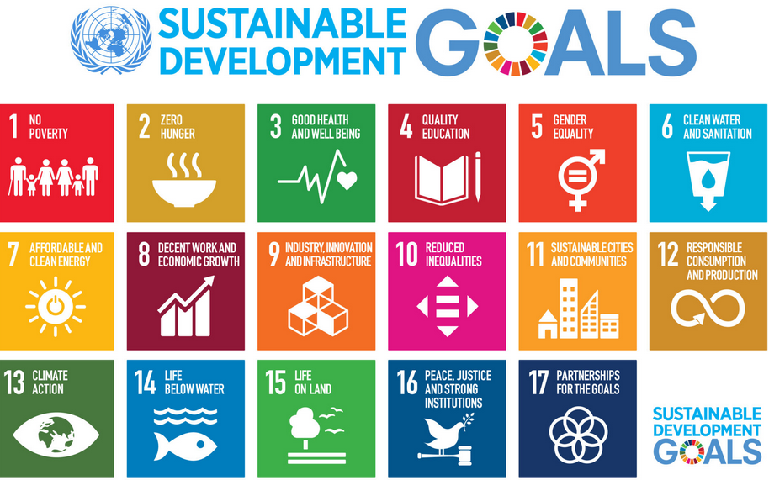
Reference concepts for Industry 5.0

Slide 9
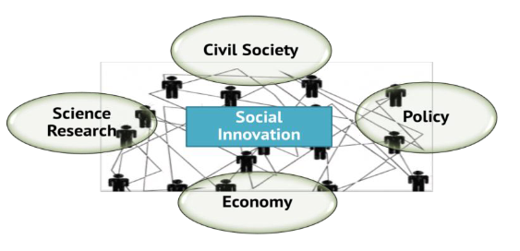
Implication: Industry 5.0 needs to be embedded in regional innovation ecosystems
Dialogue between Enterprises (Workers) Regional Actors (Civil Society) and other actors
(Source: Howaldt et al., 2019, 16)
Aligning production with more purpose: Good, fair + societal useful work
-> how we produce + what & how much we produce
Introducing a second focus: Human-Centricity + Regional Centricity
Regional Co-Governance
-> Decision making from problem definition over interventions up to evaluation

Slide 10
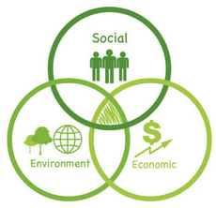
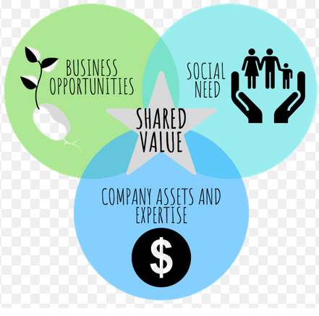

Starting Points: Social Responsibility and Shared Value
Field of application: large companies
Voluntariness / insufficient commitment
Lack of integration into the core business strategy
Greenwashing
Limited liability and accountability
Not ready to overcome neoliberalism
Role of civil society is mentioned but underdeveloped
Selective understanding of social needs
Employees and their representatives hardly play a role.
Employee-related topics are given little consideration
Short-term profit orientation
Not ready to overcome neoliberalism
Role of civil society not considered

Slide 11
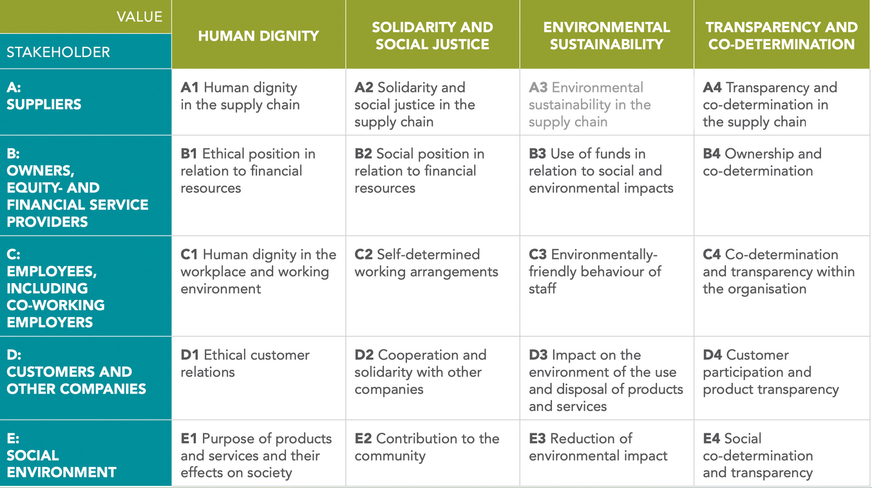
Audit Matrix 5.0 (Common Good Economy)
Lack of incentives for companies
Lack of anchoring in the “real economy”
Alternative approach
Negative impact on competitiveness
Civil society no actor in audit process
Source: https://www.econgood.org/apply-ecg/common-good-matrix/

Slide 12
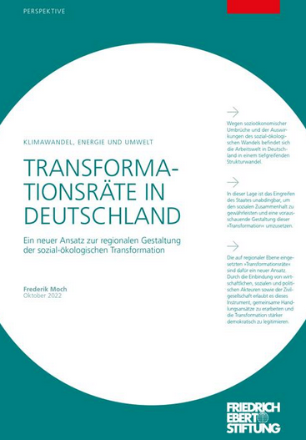
Transformation Networks
„By involving economic, social and political actors as well as civil society, this instrument allows joint approaches to be developed and the transformation to be more democratically legitimized.“ (Moch 2022)
Structure
Clear mandate and official convening of actors
Central coordination
Administrative support (own office)
Financial resources
Analysis of cross-sector challenges in a region
Development of action strategies and measures
Initiation and co-design of projects
Advice, knowledge management and strategic exchange
in working groups
According: Moch 2022

Slide 13
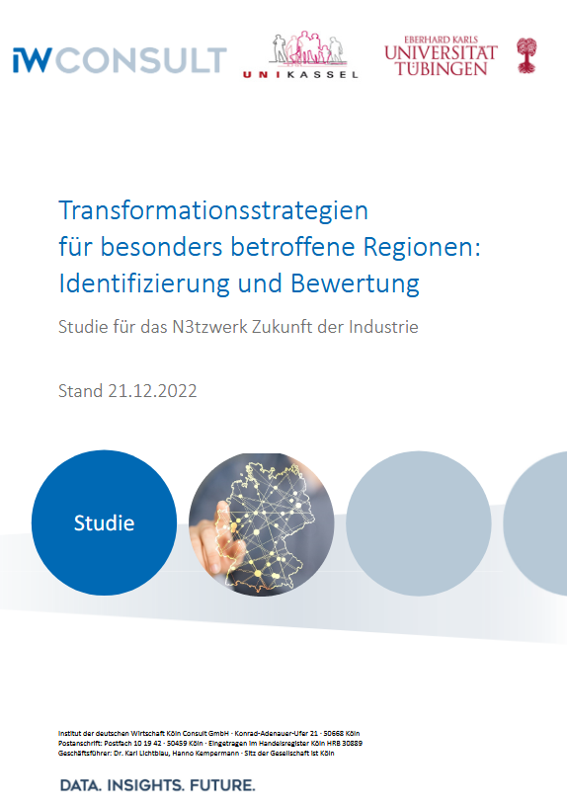
Evaluation
Core regional actors (industry, municipalities, training providers) were actively involved and contributed in shaping network strategies
Coordination challenges: differing priorities and capacities across actor types.
Participation varied: smaller businesses and municipalities sometimes struggled; larger players could dominate
Limited engagement beyond formal stakeholders: civil society and citizen groups were mostly absent.
Implementation constraints: networks could plan strategies but often lacked funding or authority to act fully
Funding for some networks has been extended through the end of 2026

Slide 14

Conclusion
Regional
Centrification
Full transition to Industry 5.0 only becomes real when it moves beyond the factory walls and into regional innovation eco-systems.

Slide 15

Thank you very much for your attention!

Slide 16
Sources
Breque, M., De Nul, L., & Petridis, A. (2021). Industry 5.0: towards a sustainable, human-centric and resilient European industry. Luxembourg, LU: European Commission,
Directorate-General for Research and Innovation. Available under: https://data.europa.eu/doi/10.2777/308407 (Accessed: 10.01.2026).
Eberhard, S. (1998). Wertorientierte Unternehmensführung. Der modifizierte Stakeholder-Value-Ansatz. Wiesbaden: Springer.
Howaldt, J. & Schwarz, M. (2010). „Soziale Innovation“ im Fokus. Skizze eines gesellschaftstheoretisch inspirierten Forschungskonzepts. Bielefeld: transcript Verlag.
Hirsch-Kreinsen, H. (2025): The Challenge of Socio-Technical Work Design. An essay on the Open Issues of Industry 4.0 and Industry 5.0. Beiträge aus der Forschung, Bd. 226, Dortmund.
Raworth, K. (2017). Doughnut Economics: Seven Ways to Think Like a 21st-Century Economist
Moch, F. (2022). Transformationsräte in Deutschland. Ein neuer Ansatz zur regionalen Gestaltung der sozial-ökologischen Transformation. Friedrich-Ebert-Stiftung: Brüssel.
Verfügbar unter: https://library.fes.de/pdf-files/bueros/bruessel/19952.pdf (Accessed: 10.01.2026).
Renda, A., Schwaag Serger, S. & Tataj, D. (2021). Industry 5.0, a transformative vision for Europe: governing systemic transformations towards a sustainable industry, Publications Office
of the European Union. Available under: https://op.europa.eu/de/publication-detail/-/publication/38a2fa08-728e-11ec-9136-01aa75ed71a1) (Accessed: 10.01.2026).
Schöneberg, K., & Vitols, K. (2022). Social Value von Unternehmen: Die Ansätze großer Wirtschaftsprüfungsunternehmen. Studie der Hans-Böckler-Stiftung Nr. 473. Verfügbar
unter: Social Value von Unternehmen. Die Ansätze großer Wirtschaftsprüfungsunternehmen (boeckler.de) (Zuletzt aufgerufen: 01.02.2024).

